Slide 1
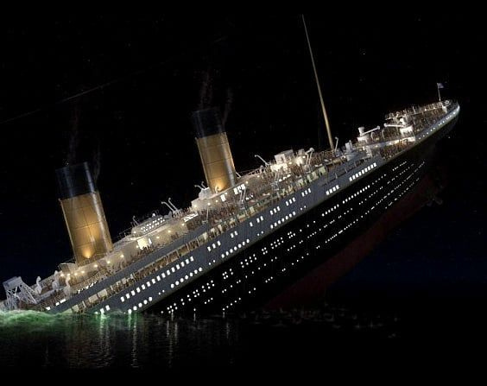

Titanic
Unsinkable Ship

Slide 2

The RMS Titanic was a British luxury passenger liner that tragically sank on its maiden voyage. It set sail from Southampton, England, on April 10, 1912, heading to New York City. On April 14, 1912, the ship struck an iceberg and sank in the early hours of April 15, 1912.
The Titanic was renowned for its size and luxury, being the largest ship afloat at the time. It featured opulent first-class accommodations, including a gymnasium, swimming pool, and fine dining restaurants1. Despite its advanced safety features, such as watertight compartments, the ship was not equipped with enough lifeboats for all passengers and crew.
The disaster resulted in the deaths of approximately 1,500 of the 2,224 passengers and crew on board2. The sinking of the Titanic led to significant changes in maritime safety regulations and has remained a poignant symbol in popular culture

Slide 3


Slide 4
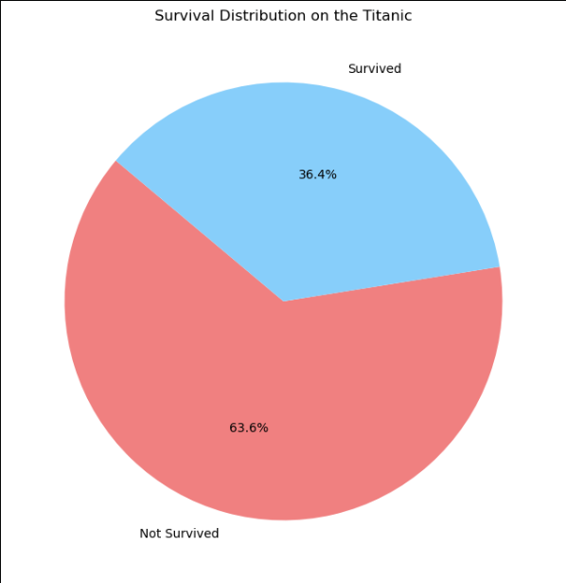

Slide 5


Slide 6


Slide 7
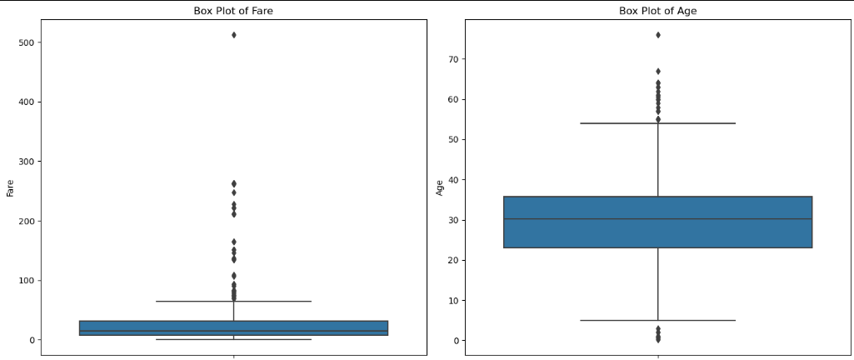

Slide 8
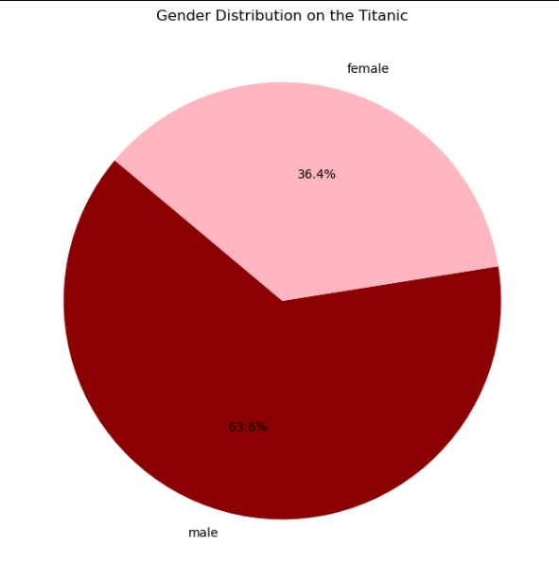

Slide 9
